Slide 1
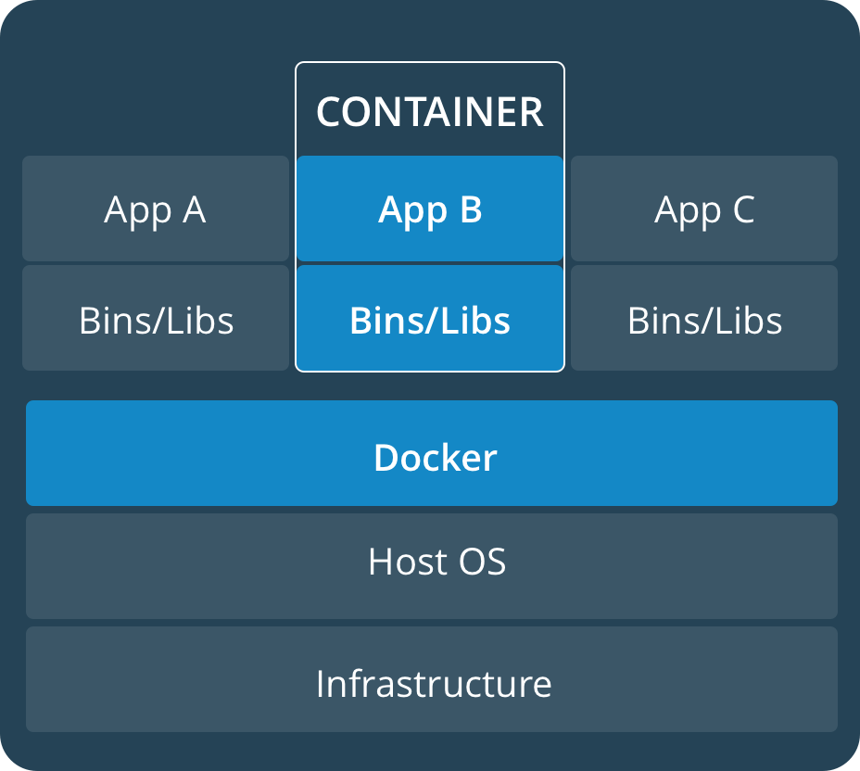

Real-time containerized applications Project phases
Determine system configuration, OS, RT-patch and engine
Evaluate latencies with different configurations in different settings: Bare metal, virtualized with direct hardware access (C5), virtualized standard instance
Develop a monitoring Framework, Benchmark
Setup a static schedule for a set of RT-applications to run in containers distributed on the available vCPUs
Develop a small specialized uni-kernel for the containers (depends on Docker support)
Elaborate dynamic scheduling algorithms for the same purpose and implement them in an orchestration service that runs in a separate container and manages the running applications

Slide 2
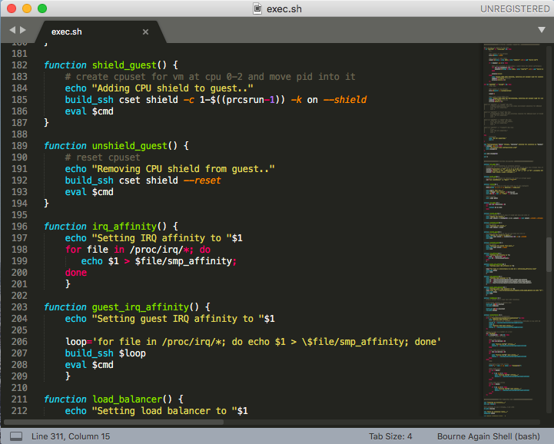
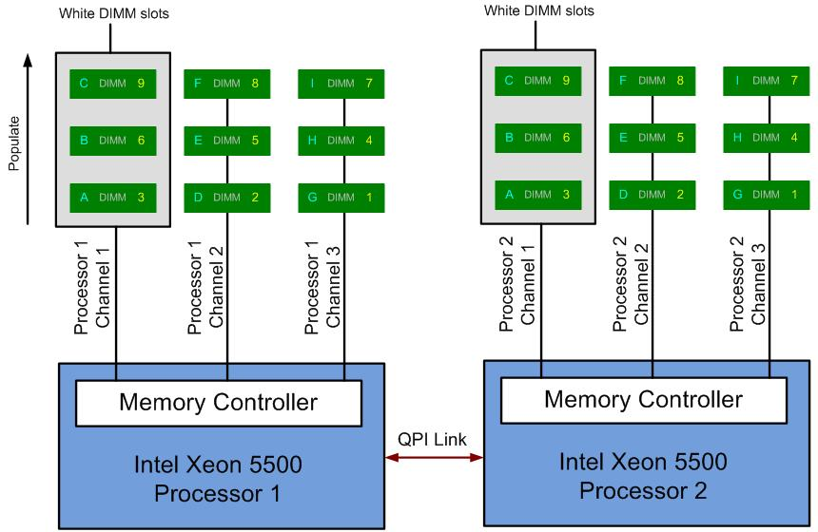
Performed steps
Identification of configuration and candidate guest OSs, evaluation of kernel patch variants
A test script has been created to automatize the test execution, including automatic hardware detection
Basic and migration tests with container Engines and RT run configuration, run on bare-metal, AWS T3 and AWS C5
Recreated images with newer OS versions and patches for performance comparison and endurance tests (Ubuntu 18.04 LTS)
Paper submitted documenting the feasibility evaluation of migrating from bare metal to a virtualized IAAS infrastructure, ICSE – SEIP ‘19

Slide 3
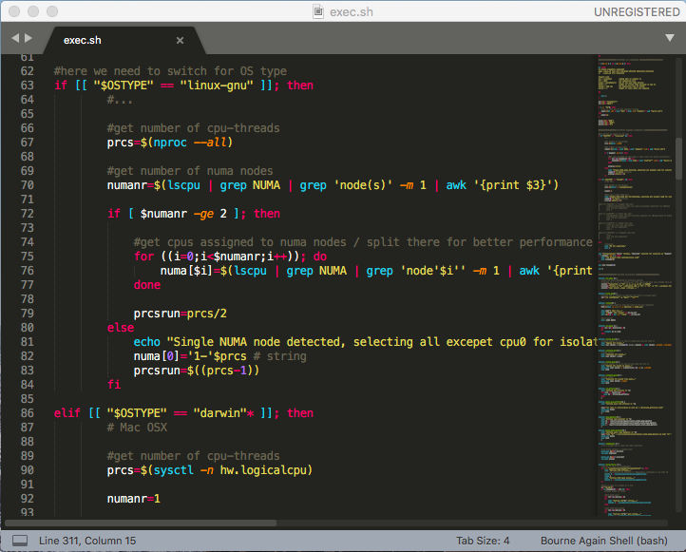
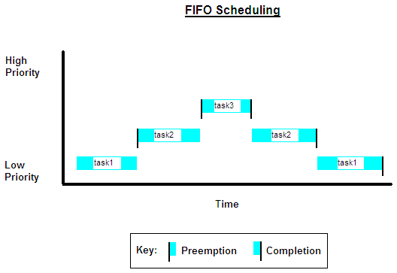
Progress of tests (now)
Selection and deployment of a monitoring system
Configuration of a new test suite (script) for endurance tests and more detailed evaluation of overshoots: Comparison Bare Metal vs. AWS T3 vs. AWS C5
Comparison of results and evaluation of possibilities
Conclusion of paper 2, publication of results latency and performance, soft/ hard limits evaluation, venue TBD
Selection and deployment of a monitoring system
Ideation of a static offline schedule for a set of RT tasks per CPU, configuration and run of such schedule using dummy counting instances (rt-app)
Creation of a simple orchestrator, application running in the same container space -> IPC

Slide 4

Future steps
Study of Symmetric MultiProcessing (SMP) Hard-real-time literature and algorithms (research status)
Introduction of dynamic SMP scheduling based on the standard EDF and CBS-GRUB algorithms
Extension of the orchestrator, dynamic, performance oriented scheduling for the EDF case
Exploration of progress: Docker support for Uni-Kernels and alternatives

